Slide 1
Plan for data collection
Mushroom Bed scanning using MK1 harvester

Slide 2
OBJECTIVES
Collecting mushroom size data (time series data) three times a day starting from 8 am e.g. there would be 3 time-step scans
Calculating growth rate(GR) for every available size e.g. starting with 15mm and upto 80 mm every 4 hours to build data pool for forecast system e.g. GR/4hrs
Pre and post scan for picking analysis
Plan in snapshot:
In each time-step scan all available mushrooms will be compared in terms of growth in 4 hours to find out growth rate. Growth rate will be calculated for individual sizes. Based on that, forecast data would be constructed, so the model would be

Slide 3
ACTIVITIES
There will be pre and post picking scan for picking data collection. This depends on farm's timing (tbc)
For forecast scan we need 3 scans starting from 8 am to 5 pm. One at 8 am following at 12 pm and the last one being at 4 pm
Confirmation from Farm
Scanning is not meant to interrupt in their job. Farm needs to confirm what are the available times for scanning the entire shelf in a day. Setting up the Harvester and scanning the entire shelf would take approximately 30 minutes.
3 times regular/irregular forecast scan
Options for modelling: Based on the frequency and time intervals of data collection. (To be decided along with the Farm)
1. Feed Regular time intervals data to the model.
2. Manipulate the irregular time interval data to make it regular and then feed it to the model.
3 Feed the irregular time interval data to the model. Need to find the suitable model that accepts irregular time interval data.
Scan | Time | Post scan | Time | Total scans | Per day scans
Forecast scan | 8am | ? | 10am (?) | 1 | ?(tbc)
Forecast scan/pre scan | 12pm (?) | 1 | 2 pm (?) | ?
Forecast scan | 4pm (?) | 1 | - | -

Slide 4
ACTIVITIES
Day | Flush | Tunnel state | Key task | Side task
Day 1 | Flush 2/1 | 1 day prior to 1st day of harvest (No picking involved) | Preparing Harvester for scanning | Doing necessary arrangements for head start
Day 2 | Flush 1 /2 | 1st day of harvest (Picking involved) | Scanning the bed | Monitoring data, data storage management
Day 3- Day4/5 | Flush 2/1 | 2nd day and following days (Picking involved) | Continuing scanning and data collecting | Data analysis, demonstrating farm pre-post count vs bin-size histogram

Slide 5
REQUIREMENTS
Preparing MK1 ready for scanning
Selecting suitable tunnel
Data storage system
Arrangements
Tools required: MK1 harvester, cameras set up on to the frame, storage for storing scan data
Days of stay at the farm: 5-6 days – 1 day prior to first day of harvest to next 5 days of harvest period
Work time span each day: apparently 8am to 5pm (9 hrs)
Scan time: It seems a full shelf scan would take roughly 20-30min
Flush: scanning will start with flush 2, following flush 1
Location of work: tunnels that satisfies the above
People involved: Ajay, a farm worker who is meant to do scanning, myself, the emergency contact people

Slide 6
TECHNICAL ASPECT
Alongside scanning, environmental sensor data would be collected in each timestep scan
Each scan will record individual mushrooms with size at that time. With pre and post scan picking performance would be analysed; preparing forecast dataset with growth (mm) of mushrooms from each scan, and storing mushroom images in need.
A robust tag/label based data structure will be built to store the scan data. Each scan data will be labelled on date-time for easy access and analysis
Time step scan | Mushroom data |  |  | Environment data
8 am | Size | Count |  | Air Temp, RH, CO2 level Compost pH, moisture, temperature
12 pm
4 pm

Slide 7
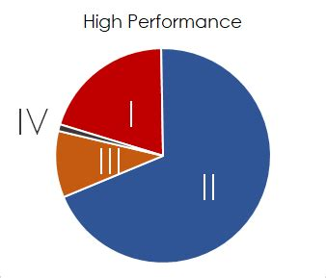
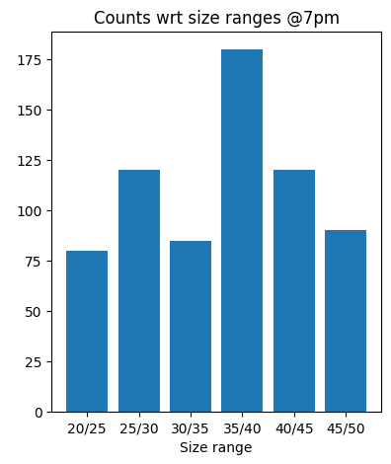
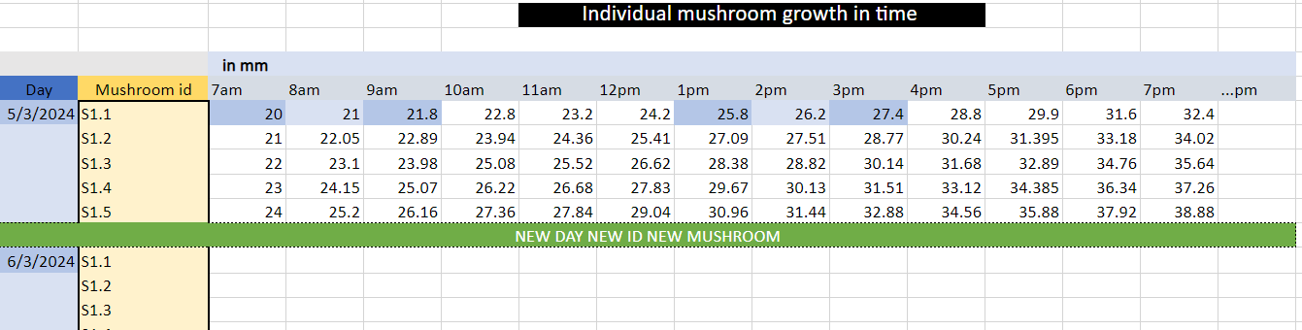
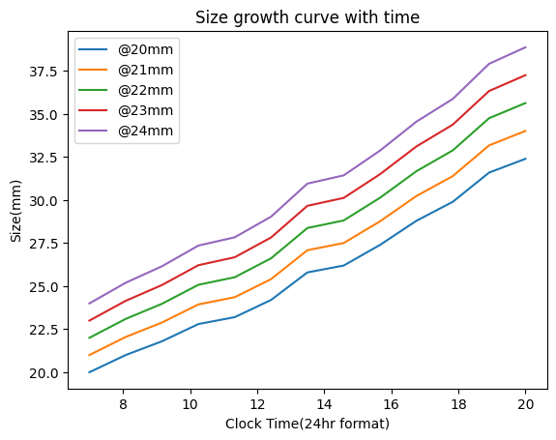
OUTCOME
Outcome:
Panel data(size) for mushrooms on bed
Growth dataset for Forecast
Picker's performance analysis
Histogram over count w.r.t size-bins
Time series growth data w.r.t size-bins
Pre and post scan

Slide 8
DATA UTILISATION
Pre and post scan:
Comparing pre scan data with post scan, picking accuracy in terms of correct size and number of mushrooms picked from certain size bin.
Pre and post scanning helping in forecast data collection:
With pre and post scanning mushroom size progression data can be fetched for example 8 am, 12pm scans alongside 4 pm scanning can be used as dataset for 4 hours forecast. Growth rate would be evaluated per mushroom size and eventually a dataset built for forecast modelling based on growth rate

Slide 9
PROS AND CONS
Scans need to be done on time as time series data collection is one the main goals
Pre and post scan would benefit -
Displaying histogram over size vs pick count, Picker's performance analysis
Preparing time series growth dataset for mushroom
Robust data management system needs to be built to store this massive data for multiple days
Each data points needs to be tagged w.r.t date-time stamp. Mushrooms need to be tracked from one time step scan to other and this is how growth of mushrooms of individual size can be monitored and concluded
Harvester will run scanning before pickers get ready for picking as pre-pick scan and once pickers are done with picking and at safe distance from bed, harvester will perform post-pick scan. This routine will be repeated three time a day. A strict H&S policy needs to be in use.

Slide 10
RISK ASSESSMENT
Task | Hazard | Plan in place | Risk level (PxS) | Overall risk
Setting up Harvester for scanning | Safety of mushroom and operator | H&S measurements for worker already active. Harvester is programmed for mushroom safety | 1x2 | 2
Scanning routine | Human coming in the way | Safety distance is maintained while harvester is on | 1x1 | 1
Handling harvester | Due to being heavy, handling and manoeuvring the harvester is tricky | Bridge and mechanical platform are being used for safe handling | 1x2 | 2
Data mishandle | Data deletion | Backup in secondary storage | 1x1 | 1
P: probability of happening S: Severity of it
Overall risk: 1-5 Low risk; 6-12: mid risk 13-16: very high risk

Slide 11
REQUESTS FROM FARM
Forecast:
Forecast for the bed what is scanned by the harvester
How much mushroom(kg) has been picked from that bed
Picker's quality involved with that bed
Environmental data(Growing card):
Environmental data from the tunnel the bed is
Weight data:
Weight w.r.t various different sizes
Record after pick weight and passes involved every pick

Slide 12
THINGS TO CONSIDER
It would be great if someone from the farm who is supposed to do future scanning, stays with us while for sometime during first and last day of scanning. It will help them understand the difficulties we face in scanning and be confident to do scanning on their own and properly
As a backup it is always good to have someone who has technical skills like controlling machinery, understanding screen options etc

